Slide 1
Introduction to Calculus
Understanding the Fundamentals of Calculus

Slide 2
What is Calculus?
Calculus is a branch of mathematics that deals with the study of change and motion.
It provides a framework for understanding and analyzing processes that involve continuous change, such as motion, growth, and decay.
Calculus is used in various fields such as physics, engineering, economics, and computer science.

Slide 3
Differentiation
Differentiation is a fundamental concept in calculus.
It involves finding the rate at which a quantity changes with respect to another variable.
Differentiation allows us to calculate slopes of curves, determine maximum and minimum points, and analyze the behavior of functions.

Slide 4
Integration
Integration is another important concept in calculus.
It involves finding the area under a curve or the accumulation of quantities over an interval.
Integration allows us to calculate areas, compute volumes, and solve problems involving cumulative quantities.

Slide 5

Applications of Calculus
Calculus has numerous applications in various fields.
In physics, calculus is used to describe motion, calculate forces, and solve problems in mechanics.
In engineering, calculus is used for designing structures, analyzing systems, and solving differential equations.
In economics, calculus is used to model and analyze economic relationships and optimize decision-making.
In computer science, calculus is used in algorithms, optimization problems, and machine learning.
Applications of Calculus

Slide 6
Limits
Limits are foundational to calculus.
They represent the behavior of a function as its input approaches a certain value.
Limits allow us to define continuity, calculate derivatives, and understand the behavior of functions at critical points.

Slide 7
Derivative Rules
Derivative rules are essential tools in calculus.
They provide a systematic way to calculate derivatives of various functions.
Some common derivative rules include the power rule, product rule, chain rule, and quotient rule.

Slide 8
Applications of Derivatives
Derivatives have wide-ranging applications.
They can be used to analyze functions, optimize problems, and solve real-world problems.
Some applications of derivatives include finding maximum and minimum values, determining rates of change, and modeling growth and decay.

Slide 9
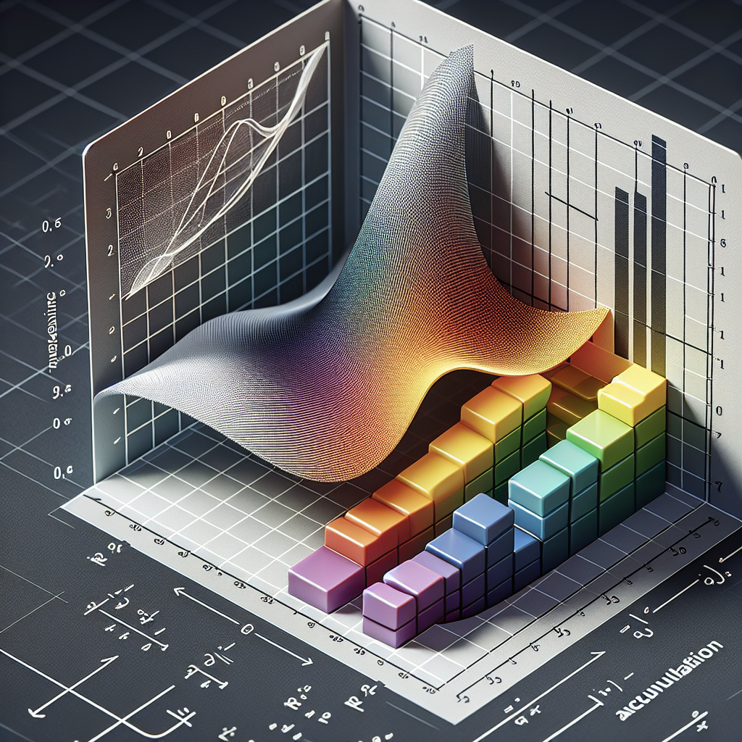
Integral Calculus
Integral calculus is a powerful tool in calculus.
It allows us to calculate areas under curves, find the accumulation of quantities, and solve problems involving continuous change.
Some common techniques in integral calculus include finding definite and indefinite integrals, using the fundamental theorem of calculus, and applying integration by parts.
Integral Calculus

Slide 10
Applications of Integration
Integration has a wide range of applications.
It can be used to calculate areas, volumes, work, and solve various problems in physics, engineering, economics, and statistics.
Applications of integration include finding areas between curves, calculating center of mass, and solving optimization problems.

Slide 11
Multivariable Calculus
Multivariable calculus extends calculus to functions of multiple variables.
It involves studying and analyzing functions with more than one input variable.
Multivariable calculus is used in fields such as physics, engineering, economics, and computer graphics to model and solve complex problems.

Slide 12
Vector Calculus
Vector calculus is a branch of calculus that deals with vector functions and fields.
It involves the study of differentiation and integration of vector-valued functions and the analysis of vector fields.
Vector calculus is used in physics, engineering, and applied mathematics to solve problems involving vector quantities and analyze vector fields.

Slide 13
Series and Sequences
Series and sequences are important topics in calculus.
They involve the study of infinite sums and the behavior of sequences of numbers.
Series and sequences have applications in various branches of mathematics including analysis, number theory, and differential equations.

Slide 14
Conclusion
In conclusion, calculus is a powerful mathematical tool that allows us to understand and analyze processes involving change.
Through differentiation and integration, we can calculate rates of change, find areas under curves, and solve optimization problems.
Applications of calculus can be found in various fields, making it a fundamental subject in mathematics and its applications.

Slide 15
References
1. Stewart, James. Calculus: Early Transcendentals. Cengage Learning, 2020.
2. Anton, Howard, et al. Calculus: Multivariable. John Wiley & Sons, 2016.
3. Larson, Ron, and Bruce H. Edwards. Calculus. Cengage Learning, 2019.

Slide 16
Thank You
Thank you for your attention!
Any questions?

